Slide 1
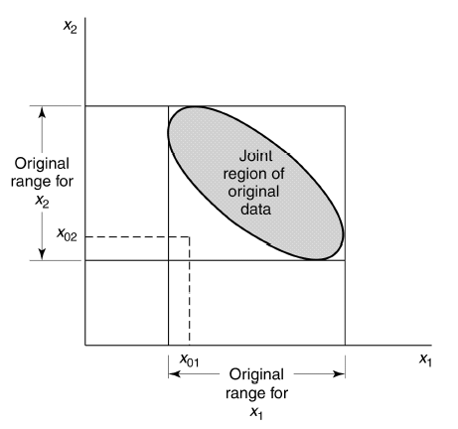
3.6 Hidden Extrapolation in Multiple Regression
In prediction, exercise care about potentially extrapolating beyond the region containing the original observations.
Figure 3.10 An example of extrapolation in multiple regression.

Slide 2
3.6 Hidden Extrapolation in Multiple Regression
We will define the smallest convex set containing all of the original n data points (x_{i1}, x_{i2}, … x_{ik}), i = 1, 2, …, n, as the regressor variable hull RVH.
If a point x₀₁, x₀₂, …, x_{0k} lies inside or on the boundary of the RVH, then prediction or estimation involves interpolation, while if this point lies outside the RVH, extrapolation is required.

Slide 3
3.6 Hidden Extrapolation in Multiple Regression
Diagonal elements of the matrix H = X(X’X)⁻¹X’ can aid in determining if hidden extrapolation exists:
The set of points x (not necessarily data points used to fit the model) that satisfy
is an ellipsoid enclosing all points inside the RVH.

Slide 4
3.6 Hidden Extrapolation in Multiple Regression
Let x₀ be a point at which prediction or estimation is of interest. Then
If h₀₀ > h_{max} then the point is a point of extrapolation.

Slide 5
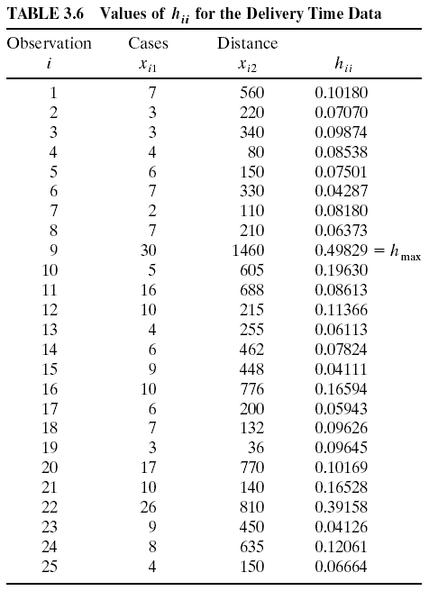
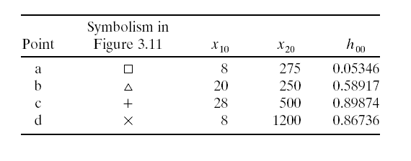
Example 3.13
Consider prediction or estimation at:

Slide 6
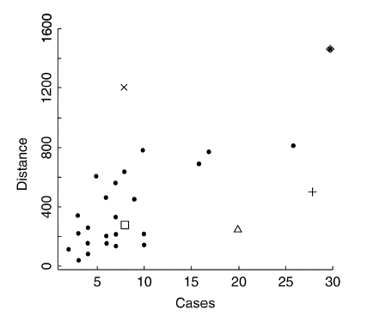
#9
d
c
a
b
Figure 3.10 Scatterplot of cases and distance for the delivery time data.

