Slide 1
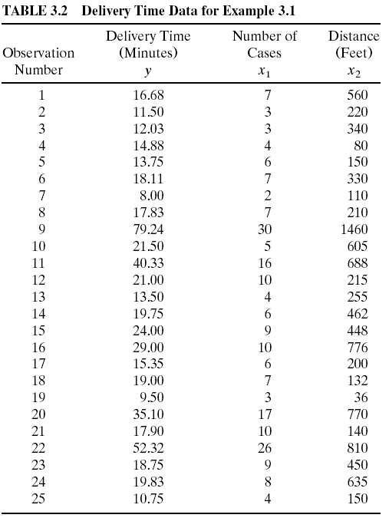
Example 3-1. The Delivery Time Data
The model of interest is
y = β₀ + β₁x₁+ β₂x₂ + ε

Slide 2
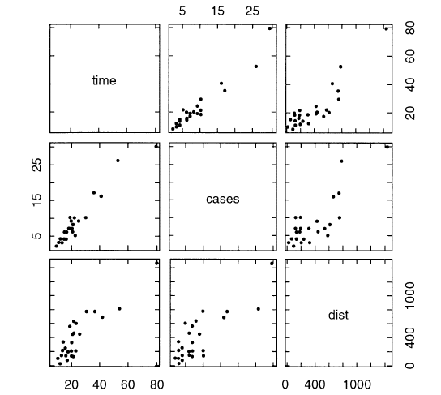
Example 3-1. The Delivery Time Data
Figure 3.4 Scatterplot matrix for the delivery time data from Example 3.1.

Slide 3
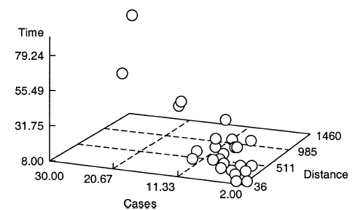
Example 3-1 The Delivery Time Data
Figure 3.5 Three-dimensional scatterplot of the delivery time data from Example 3.1.

Slide 4
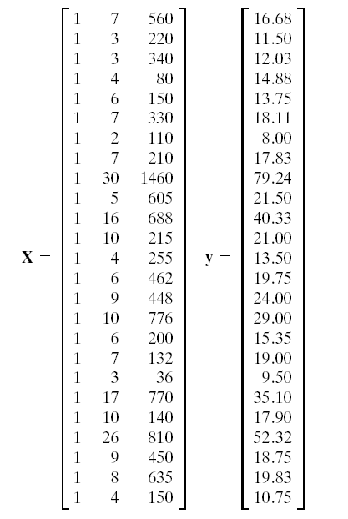
Example 3-1 The Delivery Time Data

Slide 5
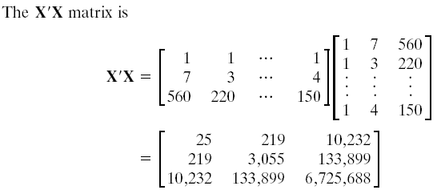
Example 3-1 The Delivery Time Data

Slide 6
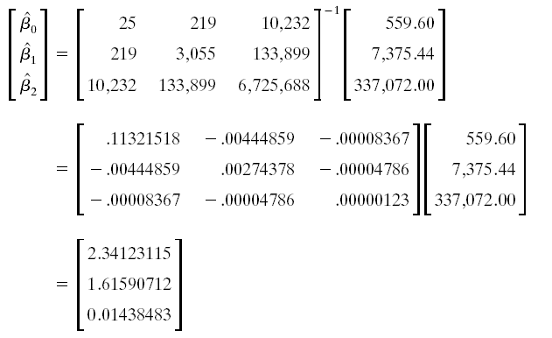
Example 3-1 The Delivery Time Data

Slide 7
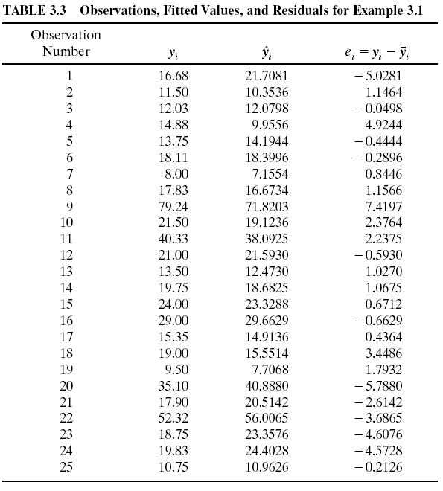

Slide 8
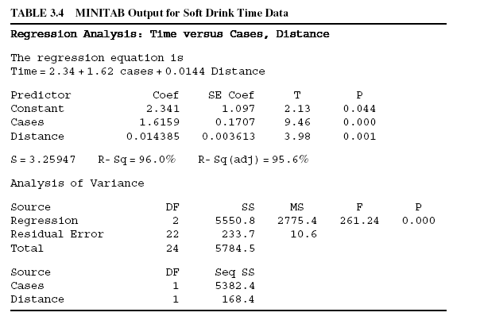
MINITAB Output

Slide 9
Example 3.2 Delivery Time Data

Slide 10
Example 3.2 Delivery Time Data

Slide 11
3.2.5 Inadequacy of Scatter Diagrams in Multiple Regression
Scatter diagrams of the regressor variable(s) against the response may be of little value in multiple regression.
These plots can actually be misleading
If there is an interdependency between two or more regressor variables, the true relationship between x_{i} and y may be masked.

Slide 12
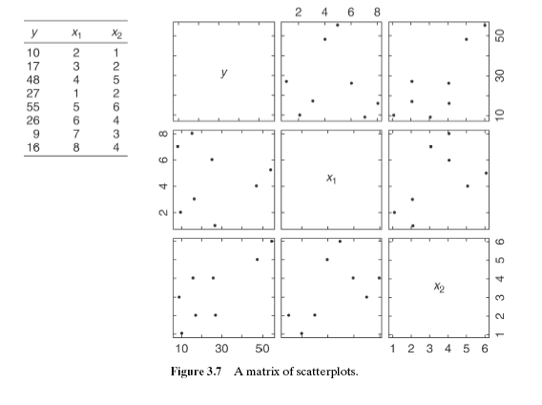
Illustration of the Inadequacy of Scatter Diagrams in Multiple Regression

