Slide 1
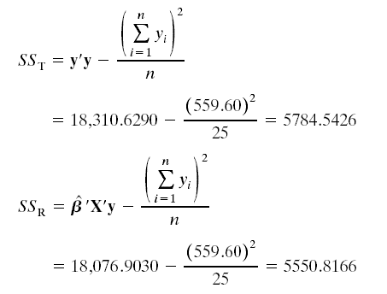
Example 3.3 Delivery Time Data

Slide 2
Example 3.3 Delivery Time Data
To test H₀: β₁ = β₂ = 0, we calculate the F–statistic:

Slide 3
Example 3.3 Delivery Time Data
The hypotheses are
H₀: β₁ = β₂ = 0
H₁: β_{j} ≠ 0 for at least one j
F_{obs}=261.24 > F_{0.05}(2,22)=3.44
Reject H₀, cases 與 distance 至少一個對time的影響是顯著的

Slide 4
3.3.1 Test for Significance of Regression
Adjusted R² Example
Say SS_{T} = 245.00, n = 15
Suppose that for a model with three regressors, the SS_{res} = 90.00, then
Now suppose that a fourth regressor has been added, and the SS_{Res} = 88.00

